Slide 1
Module 7
COMMUNICATION
Dr. Priyanjali Gogikar
Assistant Professor, SEEE
VIT Bhopal

Slide 2
Articulate Design Ideas
At the surface this sounds easy – anyone can talk, but talking isn't the challenge. The challenge is in communicating well.
How can you communicate in a way that convinces your stakeholder(s) that this is the problem to focus on? The meaning behind a particular decision? The goal you're trying to achieve?
Knowing the goal is critical, but keep in mind that the goal can change.
As we progress through the design process, new insights arise which can influence the goal or direction of the project.

Slide 3
“THE MOST IMPORTANT THING IN COMMUNICATION IS TO HEAR WHATSN’T BEING SAID”
Communication is the biggest key of articulating the design.
Communication is a success if you walk away with clear decisions that will create an effective user experience. My point is, it’s not about nice-looking slides as much as it’s about making good decisions. Communication also helps you to reduce interruption in between articulation.
There are several processes includes when we are articulating the design:
Regularly (re)define or frame the problem : It includes what we are changing in the aspect of applied design.
Adopt Holistic Thinking : Holistic design goes beyond problem solving to incorporate all aspects of the ecosystem that a product is used in.

Slide 4
Defining Designs' Purpose
1. Solve a problem
What problem does this particular design solve? Always refer to the problem, goals and big picture
2. Be easy for users
How does this particular design affect the user? What barriers are we creating or minimizing?
3. Be supported by everyone
There will always be someone who will challenge your decision. Be prepared to explain why it's better than the alternative and the other directions you explored

Slide 5
Documentation Benefits in Articulate Design
Avoids repeat conversations
Focuses on being articulate
Builds trust with stakeholders
Keeps the meeting on track

Slide 6
Storytelling is used in design as a technique to get insight into users, build empathy and access them emotionally. With stories, designers speak via character, theme, melody, and spectacle to increase the appeal of what they offer and provide a solid understanding of the users.
Seven Elements in Storytelling
Plot – what are users trying to achieve/overcome?
Character – who are the users: not just demographically, but what insights do you require to understand what they’re truly like?
Theme – how can you establish a trustworthy presence to them?
Diction – what will your design say to users and how?
Melody – will the overall design pattern appear pleasant and predictable to users, moving them emotionally?
Decor – how will you present everything so the graphics match the setting the users can sense?
Spectacle – how can you make your design outstanding so users will remember it?

Slide 7
Six Rules in Storytelling
Self knowledge and awareness
Clear structure and purpose
Have a character to root
Appeal to our deepest emotions
Surprising and unexpected
Simple and focused

Slide 8





Slide 9
K-Scripts
The fastest and most flexible way to articulate a user experience
A 3 column table Who, Observable Action, Unobservable Action/ Notes
Who: The actor who performs the action, and shows the sequential relationship between a user (or users) and the product.
Observable Actions: This section describes an action that a user performs or an action that occurs by a system — as long as its something a viewer could observe.
Unobservable: Here you capture why a situation may be occurring, motivation of the users, or notes about how the system or technology works to enable this interaction. it also is a good place for others to pose questions about the interactions.

Slide 10
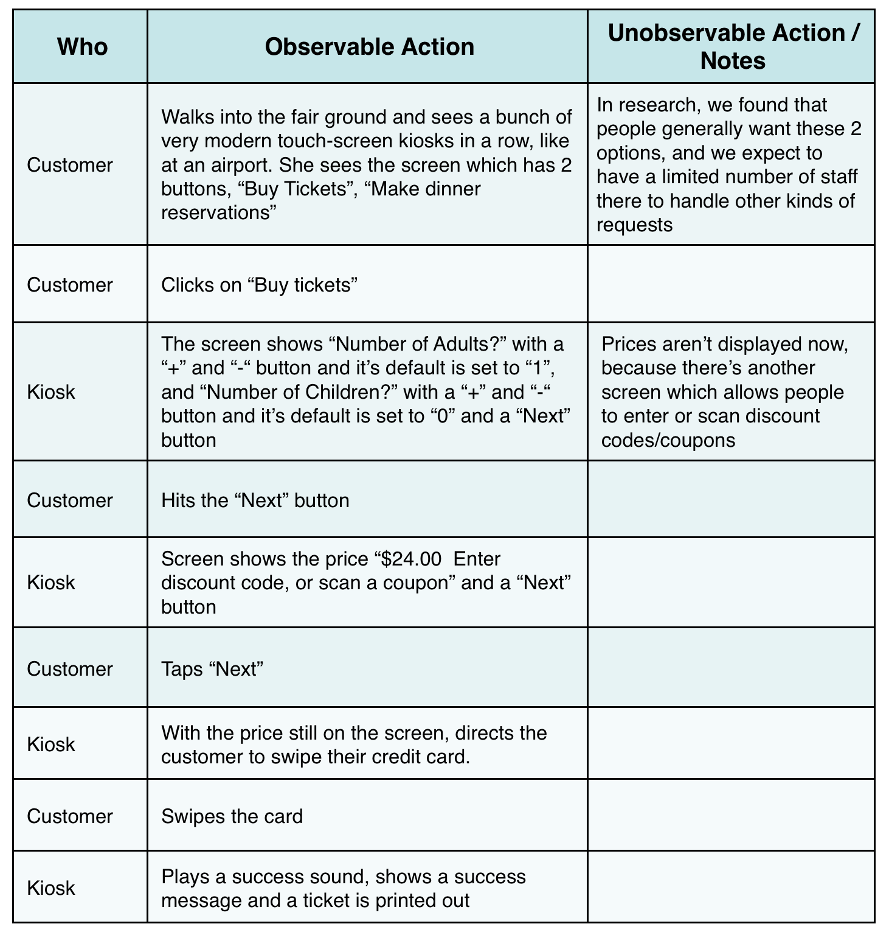

Slide 11
Sketching
Sketching is understood as a key factor for creative expression, the most effective visual thinking tools and so applied for design.
It is considered the principal approach by which design engineers externalize their concepts and where the drawings provide visual clues for refinement and revision.
A sketch is a rough design of what you want to present. It is basically a pictorial representation of thoughts, images or mental picture in your mind. It can be an idea or a concept
Sketching is a rapidly executed freehand drawing that is not usually intended as a finished work.

Slide 12
why
sketching
Creativity is a required resource for design and therefore for engineering design.
One important subject related to creativity and design is visual thinking.
Sketching are also applied help analyzing problems visually
Ideation
Explore
Visualize
Communicate

Slide 13
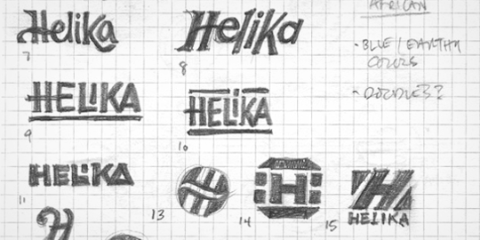
01
IDEATION
Sketching is great for rapid idea generation. A pencil or a Sharpie and a piece of paper invite loose exploration. Remember to keep on generating ideas—you’ll want to push past that first bunch of surface ideas to get the deeper concepts out of your head.

Slide 14
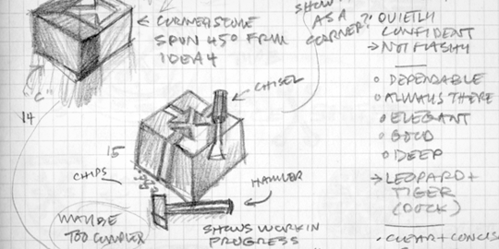
02
EXPLORE
Sketching offers you the freedom to explore alternative ideas. Early in a project it’s important to see a variety of different ideas so you can choose the best option. Sketching works well for this, as you can explore those varied ideas quickly.

Slide 15
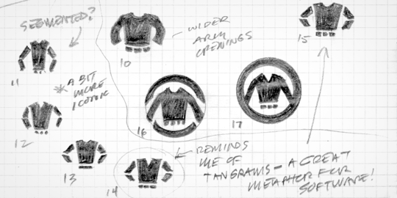
03
VISUALISE
Sketching is a combination of both physical and mental activities. So, sketching helps us to visualize. Visualization is a powerful tool. When we visualize the drawing process in our mind, we train our brains. Even without making any marks, we are essentially giving our brains practice.

Slide 16
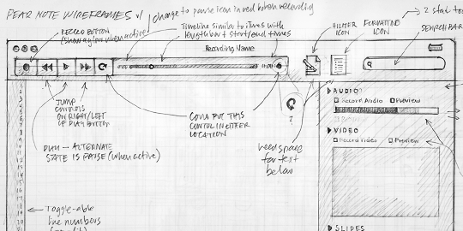
04
COMMUNICATE
Sketches have an amazing ability to foster discussions about ideas. With colleagues and especially clients, I’ve found sketches give everyone involved the permission to consider, talk about, and challenge the ideas they represent. After all, it’s just a sketch.

Slide 17

SketchUp, formerly Google Sketchup, is a 3D modeling computer program for a wide range of drawing applications.
SketchUp is designed to behave like your hand more like a pencil than complicated 3D modeling software.
Throughout the design-build process, SketchUp helps you analyze problems and get the project under construction.

Slide 18

SketchUp, formerly Google Sketchup, is a 3D modeling computer program for a wide range of drawing applications.
SketchUp is designed to behave like your hand more like a pencil than complicated 3D modeling software.
Throughout the design-build process, SketchUp helps you analyze problems and get the project under construction.

Slide 19
Dynagrams are any interactive diagrammatic visualization that allows its users to collaboratively create, alter or extend the diagram in order to conduct analyses, explore scenarios, make insights jointly visible or graphically record experiences, evaluations, and decisions.
Sankey Diagram is a type of flow diagram that depicts the flow of resources (material, energy, cost, etc.) from one node to another. The start and endpoints of each flow are called nodes and the flow paths between them are called links. There can only be one link between a pair of nodes. The value of the flow between each pair of nodes is encoded by the width of the link. The coloration of the links help establish visual mapping with their respective nodes.

Slide 20
